Slide 1
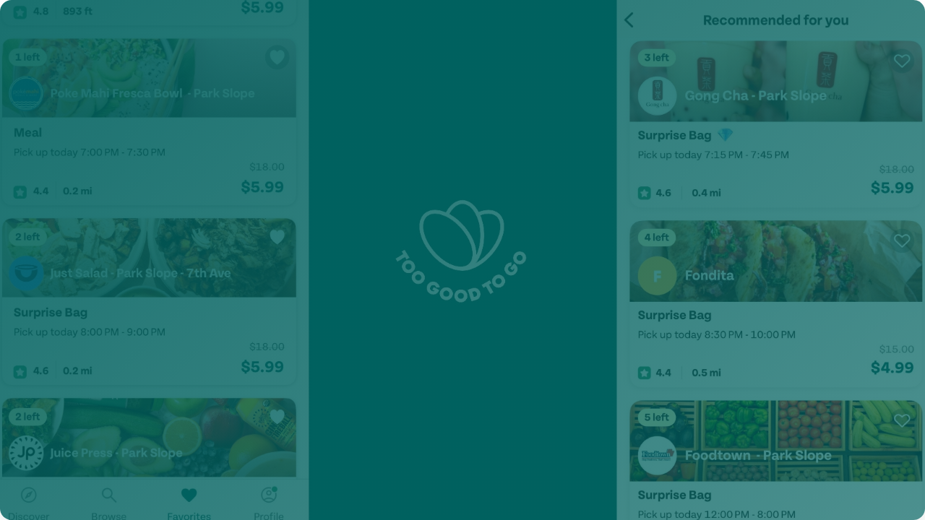

Strategic Market Expansion:
Mexico Action Plan
Authors: Yenam Dossou & Ibnouali Anas | January 2026
Fighting Food Waste Globally

Slide 2







Too Good To Go: A Global Impact Unicorn
20M+
40,000+
Founded in 2016 in Copenhagen, we are the world's leading food waste app.
Active Users
Partner Businesses
Status: Unicorn valuation (>€1 Billion)
Financials: €30M+ GMV annually, €100M+ raised (Series C/D)
Mission: Simple, scalable solutions to reduce food waste.
Leadership: CEO Søren Stephansen
500k+
17+
Tons Rescued
Countries Active

Slide 3
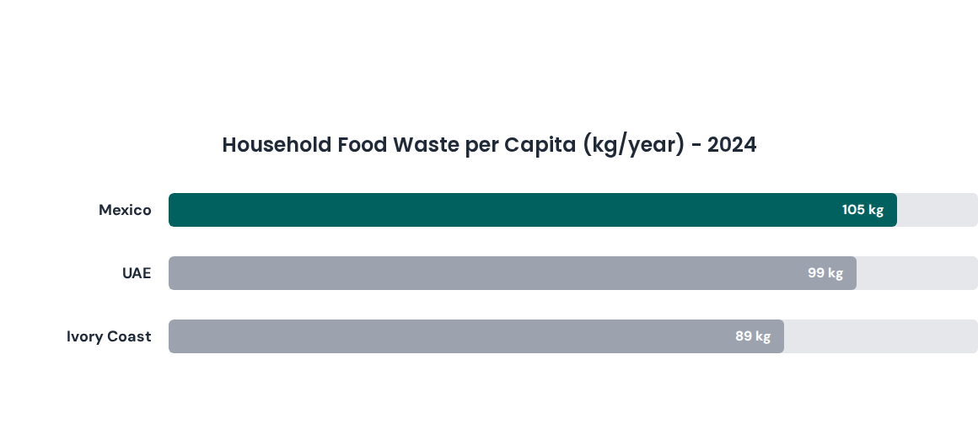
Why Mexico? High Impact Potential
Screening analysis against UAE and Ivory Coast highlights Mexico as the primary candidate due to disproportionately high household food waste and urban density.
Source: UNEP Food Waste Index 2024

Slide 4

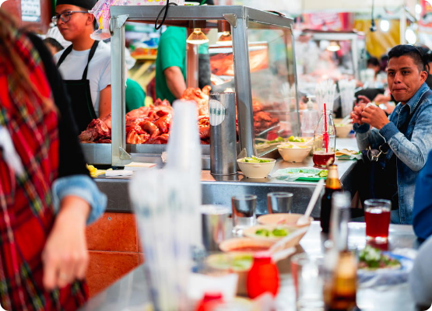
Focus Region: Greater Mexico City (CDMX)
Supply & Demand Signals
Massive Scale: Edo. de México (88,987 units) and CDMX (55,370 units) dominate the food landscape.
Growth: Eating places in CDMX growing to ~55k by 2025.
Tech Ready: 95.7% smartphone penetration (Q3 2024).
Audience: ~17.4 Million potential app-ready adults in the metro area.
"Food inflation (3.0%) supports our value proposition: Save food. Save money."

Slide 5








Entry Strategy: Direct Expansion Model
We will execute a Direct Growth model to maintain full control over brand equity, operations, and data integrity. This ensures quality as we scale.
Pilot Phase
Validation
Secondary
National
Location: CDMX
Goal: Unit Economics
Target: Hubs
Scale: Full
Establish the core engine, legal setup, and initial "anchor" partnerships.
Refine KPIs, user retention, and pickup operations before scaling.
Expand to Guadalajara, Monterrey, Puebla, and Querétaro.
Nationwide deployment once regional hubs are stabilized.

Slide 6
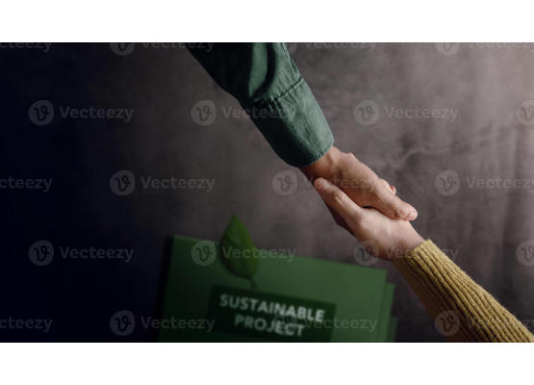
Winning the Market: Competitive Posture
Competitor | Model | Status
Cheaf | Direct Surprise Bag (Marketplace) | Strong. 1M+ users. Partners: Maison Kayser, Sanborns.
Kigüi | Cashback & B2B (Expiry Tech) | Pivoting to B2B. Not a direct consumer substitute.
Our Winning Strategy
Chain-First: Enterprise Impact Dashboards for ESG reporting.
"Surround": Anchor supermarkets + local SMB clusters.
Ops Quality: Tighter pickup windows & WhatsApp support.

Slide 7

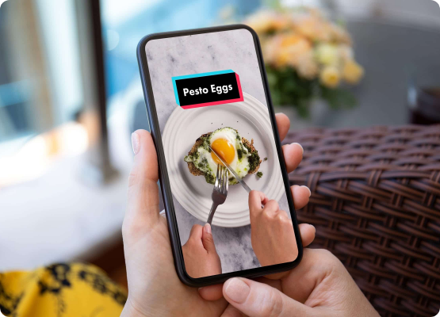
Marketing: Localized & Digital-First
Tone: Friendly & Optimistic
Aligning with local values of family and sharing. No guilt trips.
"Salva comida. Salva dinero."
"Comida buena, precio justo."
Key Channels
Viral Content
Google Maps
Merch. Support

Slide 8







Logistics & Compliance
Pickup Only
Compliance (NOM-051)
Merchant Support
Pure marketplace model. We do not handle food delivery. Consumers reserve via app and collect in-store.
Aligned with Mexican labeling regulations. Standardized onboarding dashboards for food safety guidelines.
Dedicated WhatsApp Business channel for operational coaching and SLA-based issue resolution.

Slide 9


Investment: CDMX Launch Estimates
Estimated investment for a strong Year 1 launch in Mexico City. Based on operational data.
Category | Est. Cost (USD)
Local Team (6 months) | $30,000 - $45,000
Marketing Launch | $15,000 - $25,000
Merchant Kits | ~$3,000
Legal & Accounting | $3,000 - $6,000
Contingency & Misc | ~$7,000
TOTAL | $60,000 - $90,000
Low CAPEX
High scalability driven by existing digital infrastructure and 95% smartphone adoption.

Slide 10
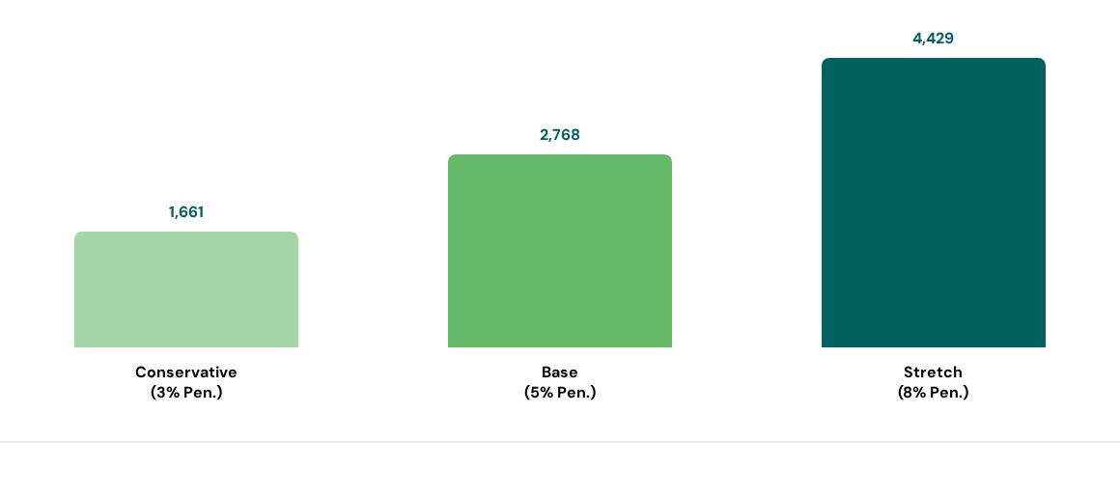
Year 1 Scenarios: Merchant Acquisition
Projected onboarded merchants in CDMX based on DENUE May 2025 base data.

Slide 11







Execution Timeline (Year 1)
Month 0-1
Month 2
Month 3-4
Month 5-6
Legal setup, city team hiring, and pilot merchant LOIs (Letters of Intent).
Merchant onboarding sprint. Campus & street activation in CDMX.
PR Push. Supermarket & Hotel chains activation. Optimize pickup windows.
Reach "Base Scenario". Prep Guadalajara & Monterrey launch.

Slide 12

Let's Make Impact Together
Mexico represents a high-potential market. With a direct expansion model and strong partnerships, we can establish TGTG as the leader.
Q&A
www.toogoodtogo.com
Environment
Economy
Society

Slide 13





Image Sources
https://images.halfhalftravel.com/mexico/mexico-city/eat-like-a-local/DAN03413.jpg?width=1000
Source: www.halfhalftravel.com
https://static.vecteezy.com/system/resources/previews/057/690/677/non_2x/sustainable-business-concepts-a-partnership-making-handshake-to-deal-the-green-project-top-view-photo.jpg
Source: www.vecteezy.com
https://www.dish-works.com/wp-content/uploads/hand-phone-tiktok-hero.jpg
Source: www.dish-works.com
https://png.pngtree.com/png-vector/20251202/ourlarge/pngtree-brown-paper-grocery-bag-filled-with-fresh-fruits-vegetables-and-bread-png-image_18100857.webp
Source: pngtree.com
https://lifehacker.com/imagery/reviews/01JP39GJA4NN9BR4CA8SPK9V8W/product-image.jpg
Source: lifehacker.com

